Slide 1
Speed control
By
-team leader: Krishna Sridhar
Deepak chakkrawarthy.S
NaNdagopalan.k

Slide 2
Traffic problem in chennai
Chennai, formerly Madras is the capital of Tamilnadu. Chennai is the Fourth Largest city in India with Population of 70.9 Lakhs
As per the Study in 2015, Chennai has the highest vehicle density in India. The city has the Second deadliest road in the country according to the NCRB’s data in 2014.
The traffic in Chennai has been worsened over the years due to limited road space and multiplying vehicles over a period.

Slide 3
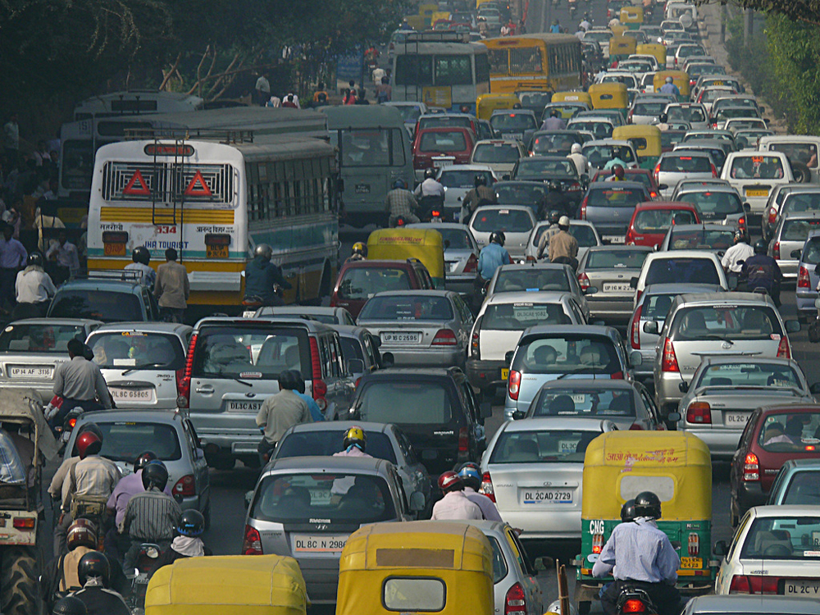
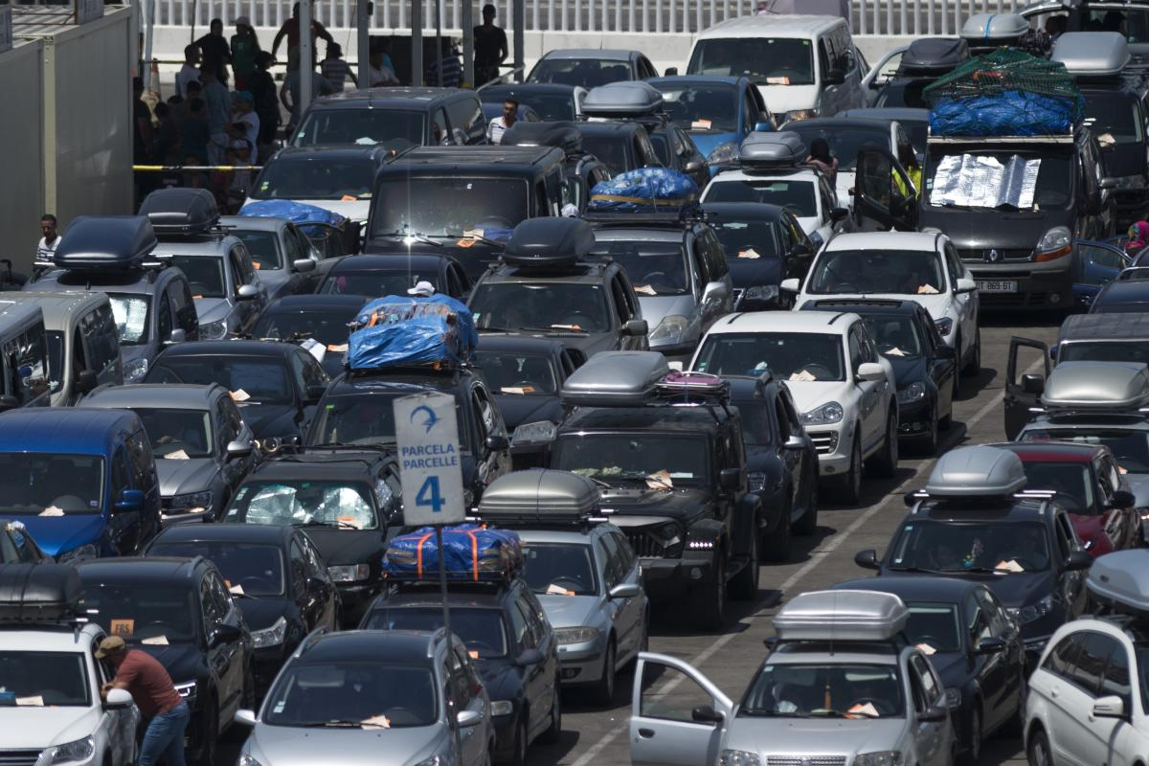
Traffic problems:
This Photo by Unknown Author is licensed under CC BY
This Photo by Unknown Author is licensed under CC BY-SA-NC

Slide 4
Speed control:
It consist of RF transmitter and receiver which shows us in pattern of 1000,1010,1001 and so on……
When the vehicle comes in range where a specific code is in each zone like school , hospital etc..
The code is transmitted to the vehicle which shows us in display that where we need to control speed in specific places such as school or Mall’s etc….
When speed Exceeds the limits the user is advised to control the speed.

Slide 5
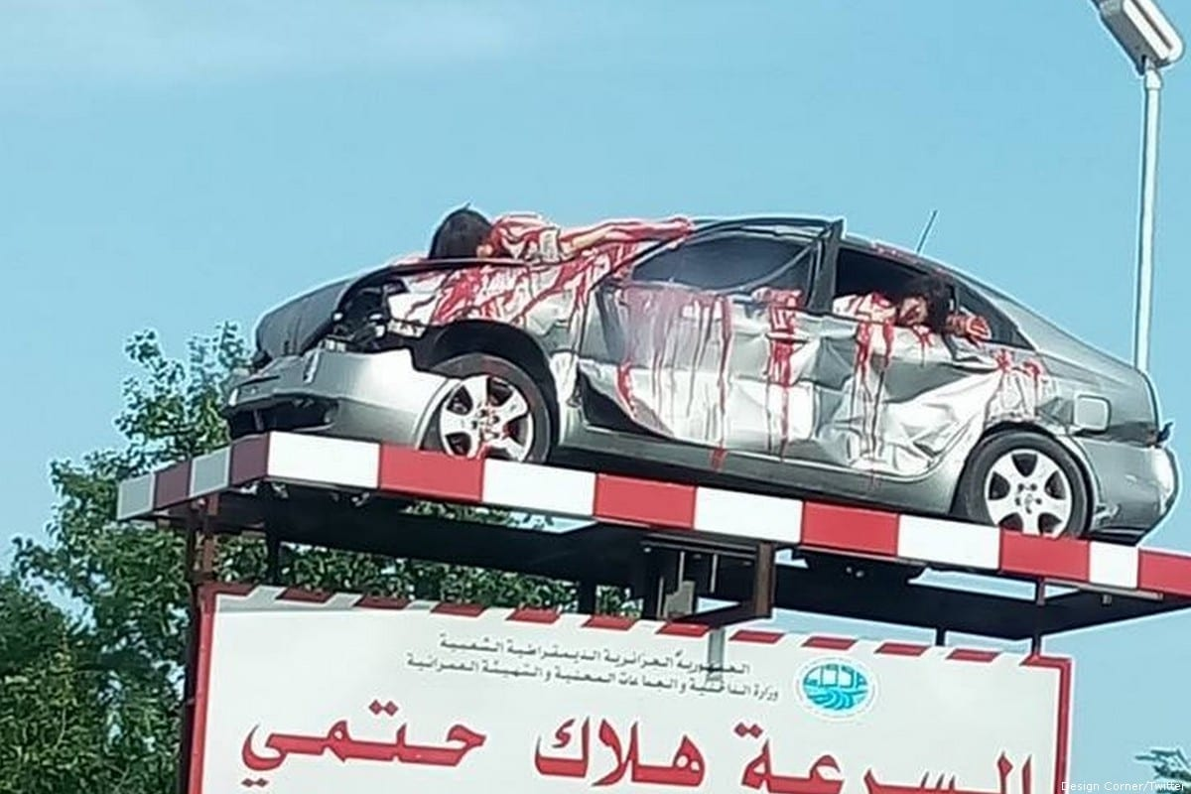
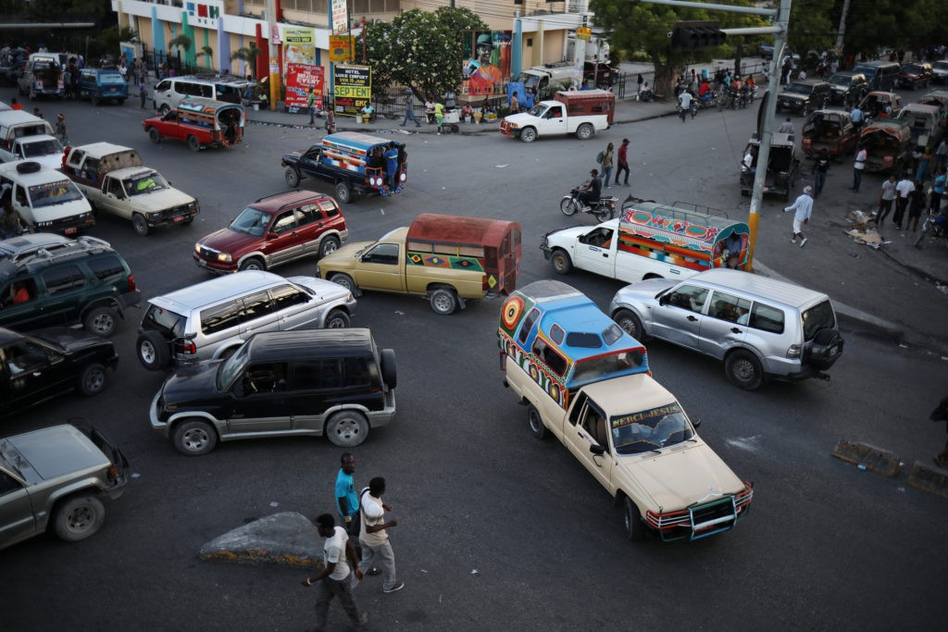
To prevent accidents:
This Photo by Unknown Author is licensed under CC BY-ND
This Photo by Unknown Author is licensed under CC BY-SA-NC

Slide 6
Advantages:
It helps in saving lives which could happen due to accidents
It keeps track of vehicles approaching specific zones.
It helps in knowing where to control the speed of vehicle.
In the Future the network will be developed so that it can work from anywhere in the world

Slide 7
Thank you

